Slide 1
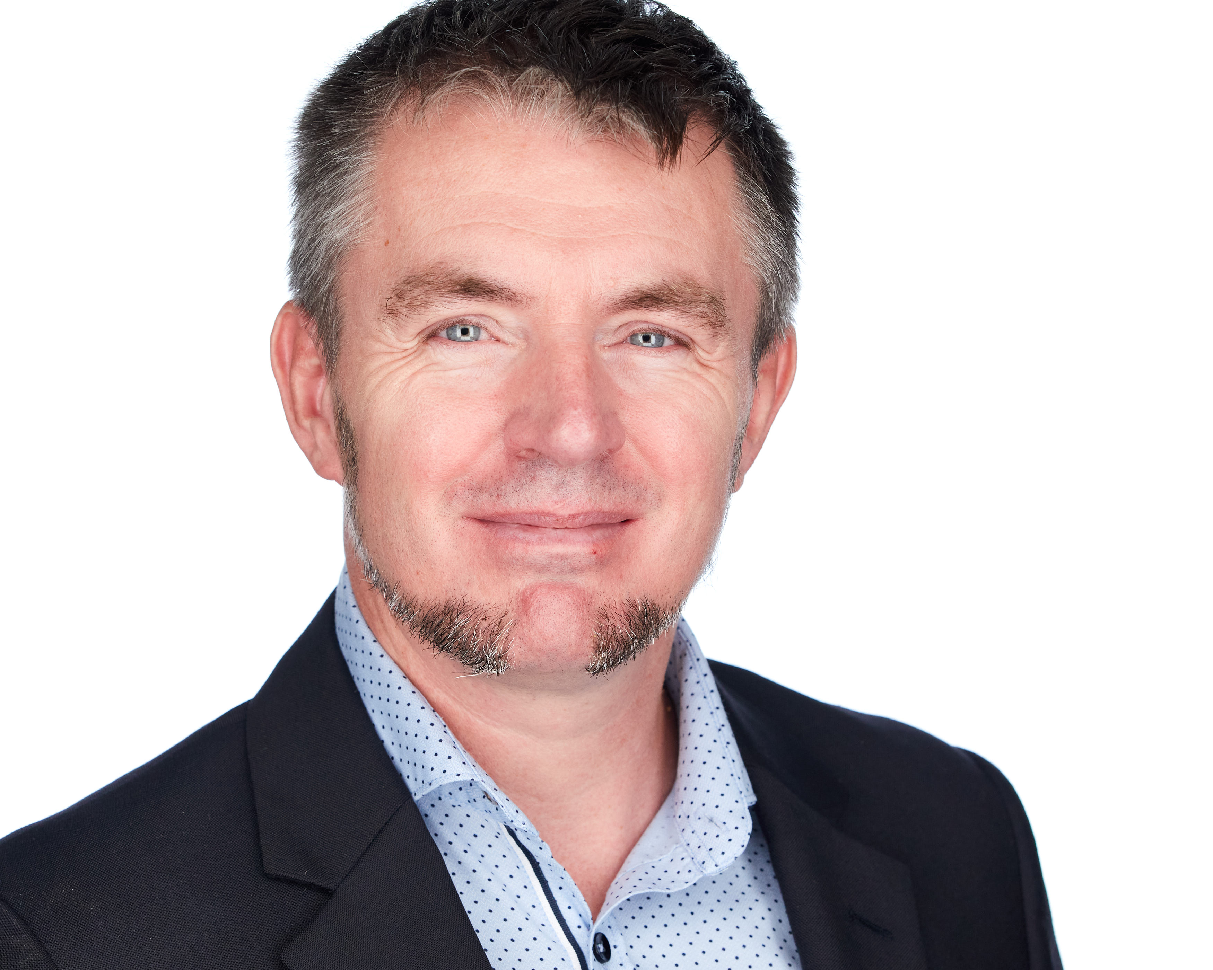





JON-PAUL BOYD
Intelligent Systems Engineer
I thrive on delivering tangible, cutting-edge, AI-enabled and analytic solutions that inform, empower & perform. I help solve business challenges and deliver value to all stakeholders through strong theory, experienced hands-on, clarity of thought and communication.
+41 (0)79 952 18 81 jp@corticalstack.ai corticalstack.ai jonpaulboyd Nyon, CH
SUMMARY
25 years I.T. experience as a software engineer, technical solutions architect & development team lead, designing solutions & executing to delivery into production for data-driven decision making.
23 LinkedIn recommendations from providing client-centric expertise to 37 global companies.
Graduated as Master of Intelligent Systems, with distinction, from De Montfort University, Leicester, U.K. (2017-2021).
Extensive experience modelling, cleansing, mining, & visualizing large data collections, including on cloud platforms.
4 years experience applying machine learning, deep learning, & heuristics to real-world problems including customer churn, breast cancer tumour classification, & manufacturing optimization.
Extensive natural language processing experience, building & evaluating state-of-the-art language models for highly relevant retrieval of biomedical information, topic modelling, named entity recognition, & pattern matching.
CAREER HIGHLIGHTS
Advanced Analytics Specialist
AC Immune | Lausanne, CH | 2020 – 2021
Driving scientific & business impact on a 6-month contract, leading ACI’s first exploration of cloud-hosted data management, machine & deep learning technologies to advance their data-driven agenda. Learned value of human-in-the-loop evaluation of A.I. solutions.
Automated tracking & visualization of the highly dynamic COVID-19 vaccine landscape for informed decision making. Clinical trial knowledge aggregation from multiple sources using Airflow & Azure ML platform pipelines, with persistence into an Azure PostegreSQL database for dashboarding & reporting with Power BI & Streamlit.
Prototyped knowledge base supporting time-pressured researchers with more effective information retrieval using large academic literature collection (400K coronavirus papers). Airflow & Azure ML pipelines automate corpus ingestion & cleansing. Heuristics & topic modelling for metadata extraction & document clustering. ElasticSearch for 4.7M paragraph repository. Fine-tuned BERT-based neural network search strategies calibrated to COVID-19 for more relevant results. Streamlit with Python for web front-end.
Proven ability to engage with different stakeholders, working with biomedical researchers to understand their workflow, & presentations “An introduction to NLP for biomedical research” to the scientific community & solutions to the CSO & CEO.
SAP HANA Technical Architect
Nestle | Vevey, CH | 2014 – 2017
Technical lead, inspiring team implementing groundbreaking analytics solution. Empowered 3000 users with recipe search to answer regulatory compliance, quantity & procurement questions previously impossible. Learned I’m still hungry for technical challenges.
Resolved SAP product shortcomings, developing tool for analytic privileges build & assign, enabling project go-live.
Quantified performance, developing tool measuring query times vs KPIs for user experience/expectation mgmt.
Acquired new skillsets to configure HANA workload management, HALM & HRF, then shared with team.
Formalized SAP HANA development best practices for Nestle application development group.
Executed 5 HANA major upgrades & migration of analytics sidecar to embedded NetWeaver/HANA dual stack.
SAP HANA Technical Architect
Bluefin Solutions | London, UK | 2014
Helped BAT realise Gartner’s Logical Data Warehouse concept by implementing HANA SDA for data federation of London & Sydney databases. Learned trust won on transparency & keeping delivery promises goes a long way.
Developed new P&L, achieving sub-second performance (legacy 2m10s), SAP Fiori KPI dashboard with item drill-down.
SAP HANA Technical Architect
HANA Propulsion Laboratory| Blonay, CH | 2013
Learned HANA by engineering piloted vehicle, with real time telemetry to cloud-hosted dB for analytics & vehicle control via openUI5 cockpit. Realised benefits of deep & wide research.
Developed data mining for game analytics & reward system tied to mission objectives & pilot behaviour.
SAP Web Dynpro ABAP Consultant
Nestle| Vevey, CH | 2010 – 2013
Revitalized team, solving skillset deficit, & guided complex dev, problem-solving & upgrades. Learned greater self-belief & improved interpersonal skills through learning from others.
Redesigned recipe change documents with new concept driven by simplicity, familiarity & customisation.
Cultivated offshore dev capability with technical training.
Microsoft Certified Azure Fundamentals
AWS Certified Cloud Practitioner

Slide 2
SAP ABAP Consultant
Belgian Railways| Brussels, BB | 2008 – 2010
Mobilized to successfully guide & rescue a failing technical project integrating RF scanning into warehouse management shipment handling. Learned love of OO dev & software in physical systems.
Individually responsible for complex bespoke development functionality within logistics execution.
Senior SAP ABAP Consultant
Cap Gemini| Middlesbrough, UK | 2000 – 2008
Analysed customer systems from ABAP perspective to enable the smooth transitioning into SAP competency centre flagship nearshoring service. Demonstrated technical & client-facing capability by delivering additional revenue earning on-site consultancy & training. Learned rewards of coaching juniors.
Supervised 3 ABAP developer colleagues, managing work pipeline and continuous coaching.
Innovated systems integration monitoring dashboard.
EDUCATION
Masters Intelligent Systems
De Montfort University | UK | 2017 – 2020
Discovered why stronger partnerships should exist between enterprise and academia.
Masters Thesis Project (90%)
Addressed 2 objectives: Support decision-making with timely & highly visual summarisation of the COVID-19 vaccine development landscape. Support time-pressured researchers with more effective information retrieval. Designed, developed & deployed a cloud-hosted knowledge base of coronavirus research & vaccine clinical trial information. Automated orchestration of high-volume structured & unstructured data aggregation, cleansing, classification, metadata creation & persistence. Automated state-of-the-art BERT-transformer model calibration to complex COVID-19 semantics & embedding of paragraph text sequences into ElasticSearch. Highly visual exploration & search with Streamlit. Search results outperformed PubMedCentral as evaluated by a medical expert.
Applied Computational Intelligence (88%) Predicting customer behaviour with tree-based machine learning classifiers. Extensive Python with data profiling & preparation, unsupervised & supervised machine learning, overfitting protection, hyperparameter tuning, model scoring, evaluation & selection.
A.I. Programming (80%)
NLP Python NLTK context-free grammars for natural language to SQL database query.
Data Mining (80%)
Data analysis & machine learning to predict risk indicators for cardiovascular disease.
Neural Networks (80%)
Evaluation of biomass & classification of network activity (intrusion, attack, normal).
Fuzzy Logic (94%)
Classifying breast cancer tumours with fuzzy inference, outperforming neural networks. Authored paper submitted to journal Applied Soft Computing for publication.
Research Methods (96%)
PhD proposal for augmented analytics.
Mobile Robots (97%)
Virtual search & rescue robot controlled via Python, implementing obstacle avoidance, sensor data fusion, environment mapping, precision navigation, victim location.
Computational Intelligence Optimization (100%) Design & build of Python-based hyper-heuristic optimization platform to address the real-world problem of scheduling optimisation. 5 example nature-inspired metaheuristic algorithms are implemented. A hyper-heuristic feature dynamically switches between low-level metaheuristics to deterministically use the most appropriate algorithm according to current problem state, or select one stochastically.
TOOLS
Machine Learning & Deep Learning: regression, decision tree, random forest, boosting, classification, clustering, neural networks
Heuristics: regular expressions, annealing, genetic, evolution, swarm, hyper
Programming & scripting: Python, JavaScript, SQL, Pandas, Numpy, spaCY, Scikit-Learn, Keras, NLTK, HTML/CSS3, SAP ABAP
Database: PostegreSQL, MySQL, MongoDB, ElasticSearch, SAP HANA
Cloud: Azure Machine Learning, blob store, compute clusters, networking, security, keyvaults, container registries
Frontend: Power BI, Streamlit
Other: Docker, Linux, GitHub, Apache Airflow, Jira
PRAISE
“Tech savvy, experienced, meticulous, dependable, ingenious & eager to learn more”
Rudi Dutli, Principal, Infosys Lodestone
“Builds comprehensive understanding of architectures involved, educating & inspiring teams & co-workers in the process. A real flair for challenging, on-the-edge development”
Trond Stroemme, Team Lead, SAP App Expertise Centre, Nestle
“An expert in his domain, a great team player. His focus on results with optimal quality is outstanding”
Norbert Rignall, Master Data Solution Architect, Nestle
AWARDS
Microsoft Certified Azure Fundamentals
AWS Certified Cloud Practitioner

